Slide 1
Regression: Contact Session 5
Dr. Chetana Gavankar, Ph.D,
IIT Bombay-Monash University Australia
Chetana.gavankar@pilani.bits-pilani.ac.in

Slide 2
Contact Session 5
Date – 03/05/2020
Time – 10am to 12pm

Slide 3
Topics to be covered
Module 5: Building Polynomial Regression Models, Overfitting and ways to combat overfitting
Polynomial Curve Fitting – Finding suitable degree of the polynomial for the problem
Overfitting
Ridge Regression and other ways of combatting overfitting
Lasso Regression
Bias-Variance Decomposition

Slide 4
Polynomial Curve Fitting – Finding suitable degree of the polynomial for the problem

Slide 5
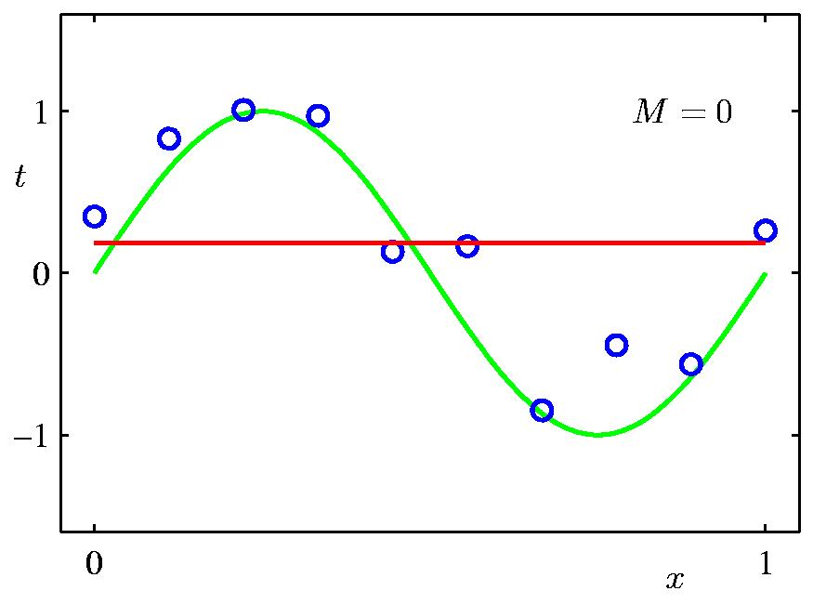

Linear Regression Problem
( x₁y₁, x₂y₂,…………. x_{n}y_{n})
y(x,w) = w₀+w₁x
min $\frac{1}{2}\sum_{n=1}^{N}{[\text{(}\text{w}\text{0}\text{+}\text{w}\text{1}\text{x}\text{n} \text{) −}\text{yn}\text{]}\text{2}}$

Slide 6
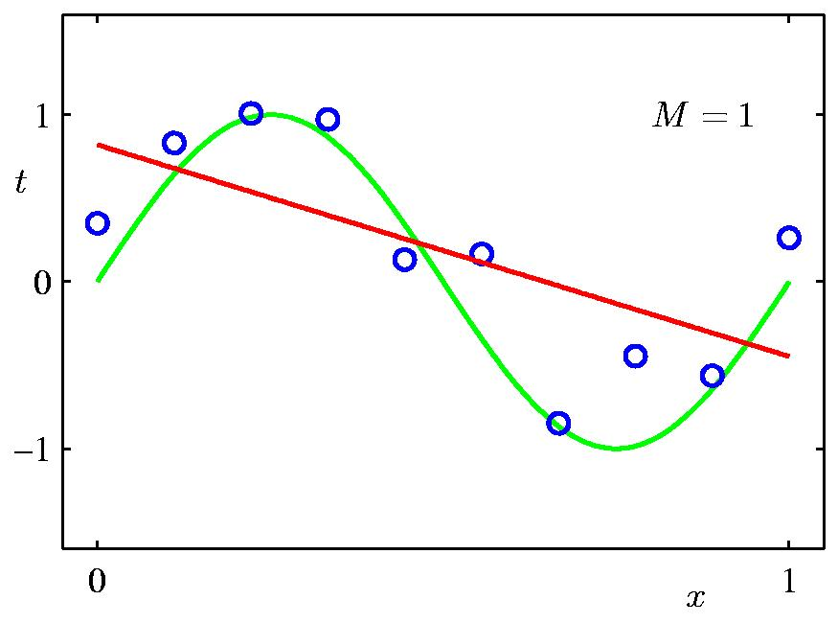
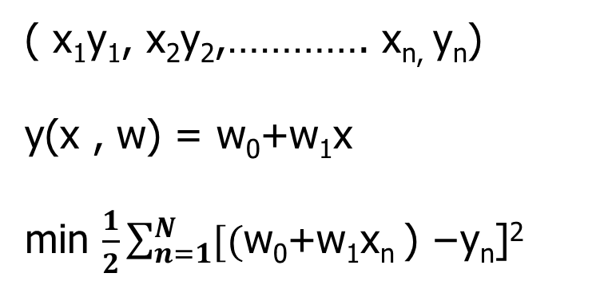
Model Selection - 1st Order Polynomial
( x₁y₁, x₂y₂,…………. x_{n,} y_{n})
y(x , w) = w₀+w₁x
min $\frac{1}{2}\sum_{n=1}^{N}{[\text{(}\text{w}\text{0}\text{+}\text{w}\text{1}\text{x}\text{n} \text{) −}\text{yn}\text{]}\text{2}}$

Slide 7
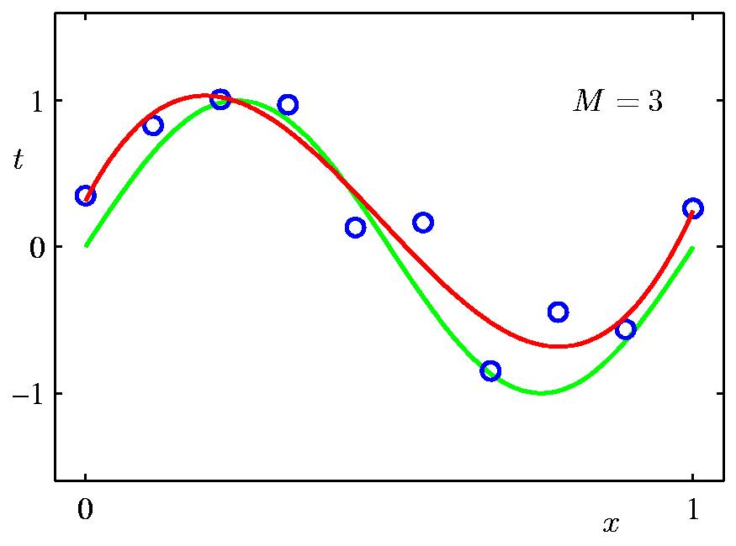
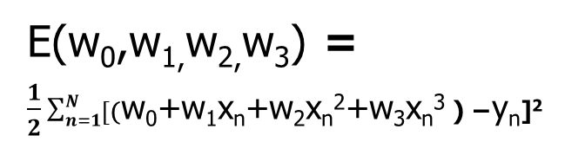
Model Selection - 3rd Order Polynomial
( x₁y₁, x₂y₂,…………. x_{n}y_{n})
y= w₀+w₁x+w₂x²+w₃x³
E(w₀,w_{1,}w_{2,}w₃) = $\frac{1}{2}\sum_{n=1}^{N}{[\text{(}\text{w}\text{0}\text{+}\text{w}\text{1}\text{x}\text{n}\text{+}\text{w}\text{2}\text{x}\text{n}\text{2}\text{+}\text{w}\text{3}\text{x}\text{n}\text{3 }\text{) −}\text{y}\text{n}\text{]}\text{2} }$

Slide 8
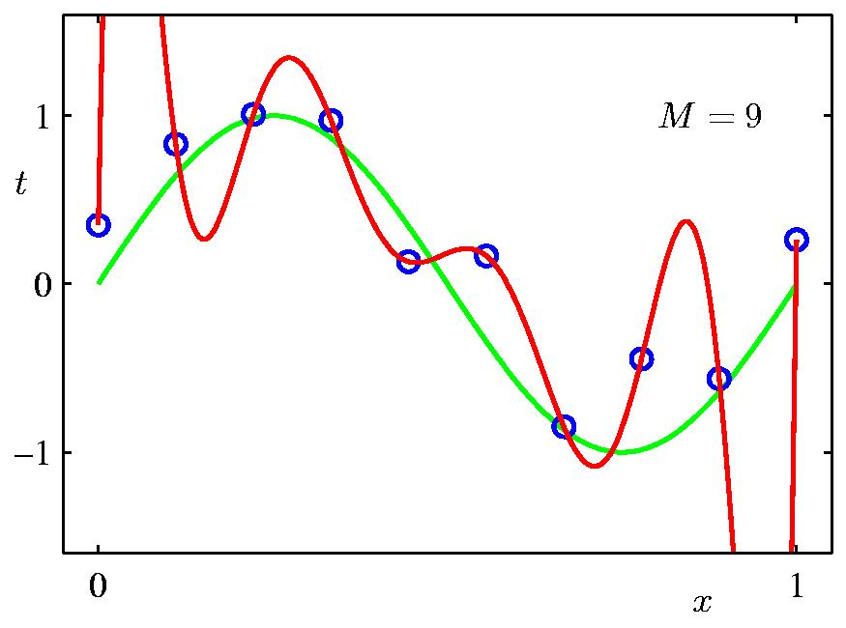
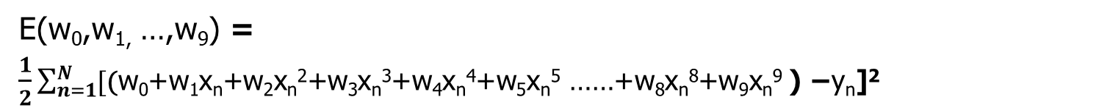
Model Selection - 9th Order Polynomial
( x₁y₁, x₂y₂,…………. x_{n}y_{n})
y= w₀+w₁x+w₂x²+w₃x³+w₄x⁴+w₅x⁵ ……+w₈x⁸+w₉x⁹
E(w₀,w_{1,} …,w₉) = $\frac{1}{2}\sum_{n=1}^{N}{[\text{(}\text{w}\text{0}\text{+}\text{w}\text{1}\text{x}\text{n}\text{+}\text{w}\text{2}\text{x}\text{n}\text{2}\text{+}\text{w}\text{3}\text{x}\text{n}\text{3}\text{+}\text{w}\text{4}\text{x}\text{n}\text{4}\text{+}\text{w}\text{5}\text{x}\text{n}\text{5}\text{ ……+}\text{w}\text{8}\text{x}\text{n}\text{8}\text{+}\text{w}\text{9}\text{x}\text{n}\text{9 }\text{) −}\text{y}\text{n}\text{]}\text{2} }$

Slide 9
Overfitting

Slide 10
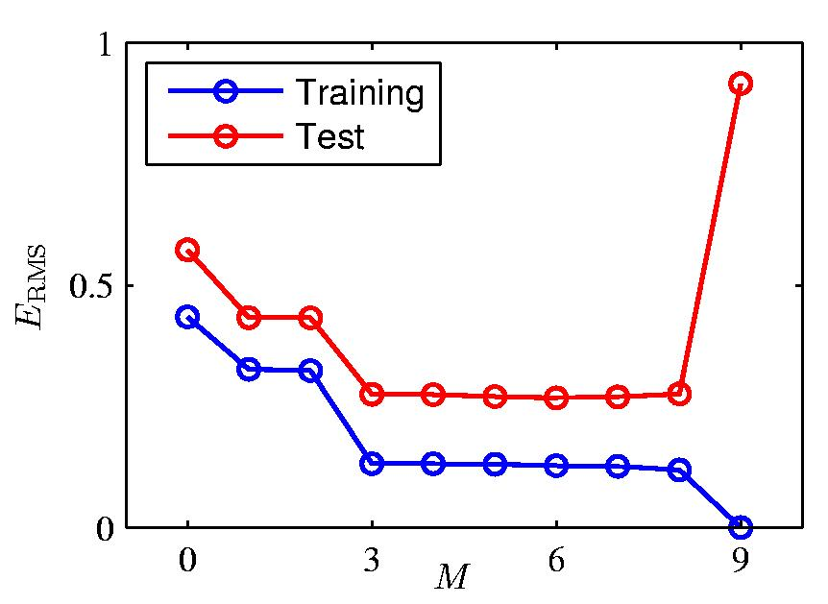
Overfitting

Slide 11
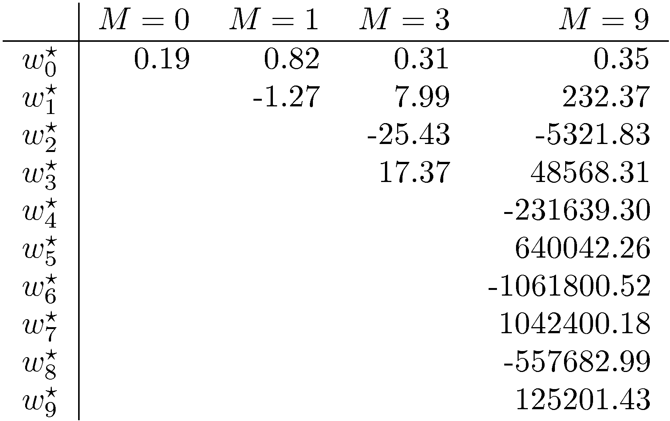
Overfitting
Polynomial Coefficients

Slide 12
Ridge Regression and other ways of combatting overfitting

Slide 13
Model Selection - 9th Order Polynomial
Data Set Size: N = 10

Slide 14
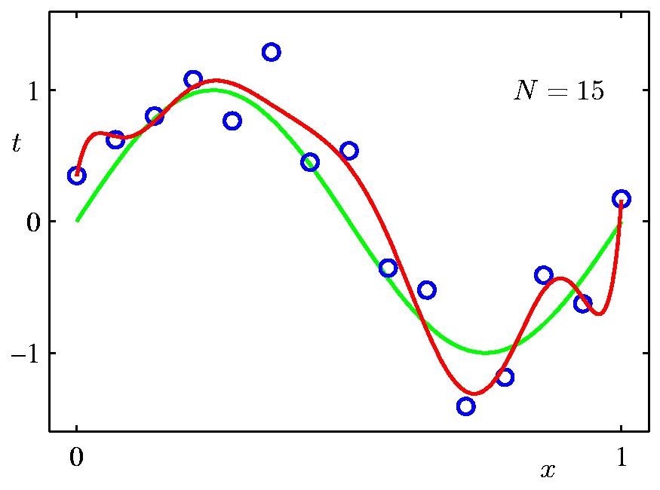
Increasing input data size
Data Set Size: N = 15
9th Order Polynomial

Slide 15
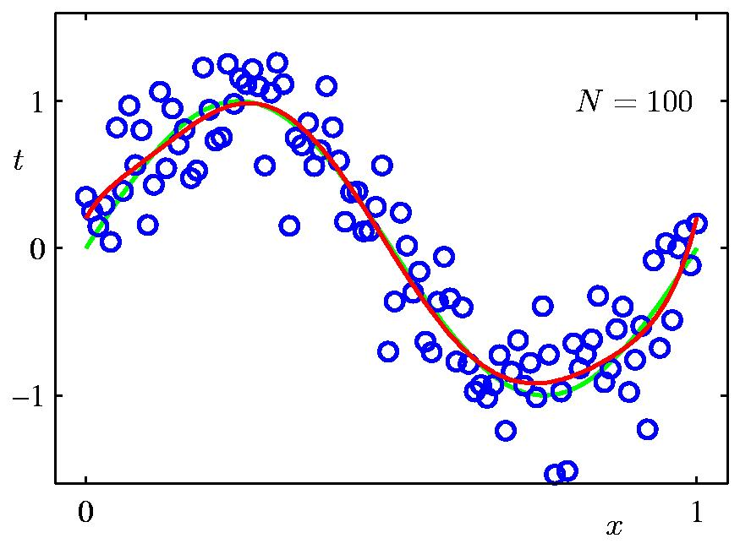
Data Set Size: N = 100
Increasing input data size
9th Order Polynomial

Slide 16
Combatting Overfitting
Problem of overfitting can be overcome by increasing the input training data points
Number of input data points should be at least more than 10 times the number of parameters or features
But what if we have less data points:
Put a bound on regression coefficients by using regularization

Slide 17
Overfitting
Polynomial Coefficients

Slide 18
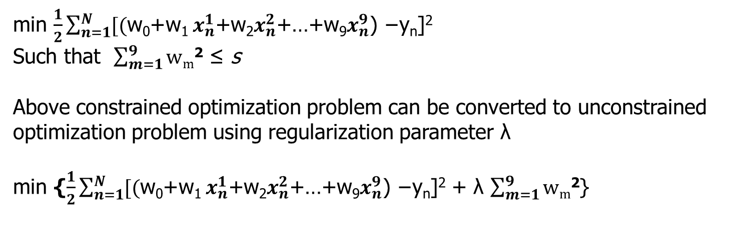
Ridge Regression
( x₁y₁, x₂y₂,…………. x_{n}y_{n})
min $\frac{1}{2}\sum_{n=1}^{N}{[\text{(}\text{w}\text{0}\text{+}\text{w}\text{1} x_{n}^{1}\text{+}\text{w}\text{2}x_{n}^{2}\text{+…+}\text{w}\text{9}x_{n}^{9}\text{) −}\text{yn}\text{]}\text{2}}$
Such that $\sum_{m=1}^{9}{\text{w}\text{m}\text{2}}$ ≤ s
Above constrained optimization problem can be converted to unconstrained optimization problem using regularization parameter λ
min {$\frac{1}{2}\sum_{n=1}^{N}{[\text{(}\text{w}\text{0}\text{+}\text{w}\text{1} x_{n}^{1}\text{+}\text{w}\text{2}x_{n}^{2}\text{+…+}\text{w}\text{9}x_{n}^{9}\text{) −}\text{yn}\text{]}\text{2}}$ + λ $\sum_{m=1}^{9}{\text{w}\text{m}\text{2}}$}

Slide 19
Regularization parameter λ
Typically 0 < λ < 1
Pickup λ where the test error is minimum

Slide 20
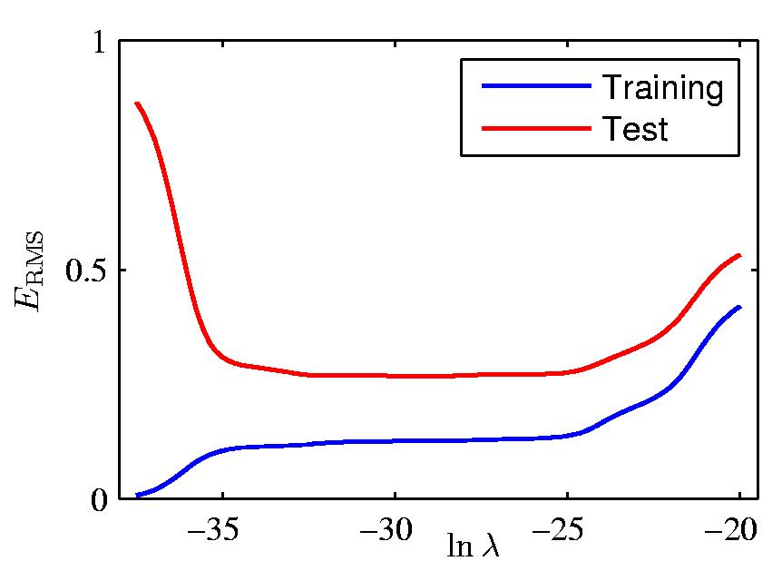
Regularization: E_{RMS} vs. ln λ

Slide 21
Lasso Regression

Slide 22
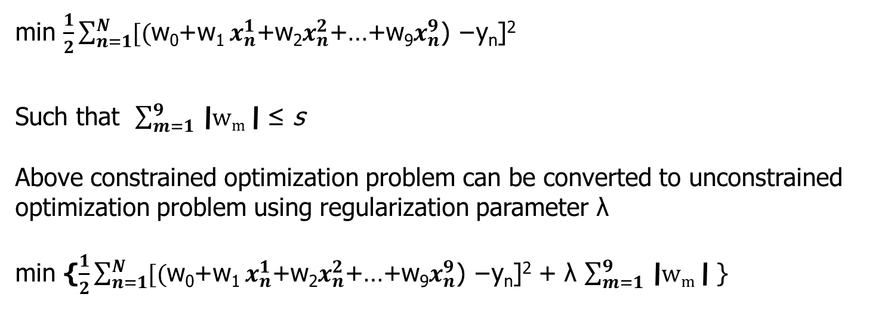
Lasso Regression
( x₁y₁, x₂y₂,…………. x_{n}y_{n})
min $\frac{1}{2}\sum_{n=1}^{N}{[\text{(}\text{w}\text{0}\text{+}\text{w}\text{1} x_{n}^{1}\text{+}\text{w}\text{2}x_{n}^{2}\text{+…+}\text{w}\text{9}x_{n}^{9}\text{) −}\text{yn}\text{]}\text{2}}$
Such that $\sum_{m=1}^{9}{\text{\backslash }\text{w}\text{m}\text{\backslash }}$ ≤ s
Above constrained optimization problem can be converted to unconstrained optimization problem using regularization parameter λ
min {$\frac{1}{2}\sum_{n=1}^{N}{[\text{(}\text{w}\text{0}\text{+}\text{w}\text{1 }x_{n}^{1}\text{+}\text{w}\text{2}x_{n}^{2}\text{+…+}\text{w}\text{9}x_{n}^{9}\text{) −}\text{yn}\text{]}\text{2}}$ + λ $\sum_{m=1}^{9}{\text{\backslash }\text{w}\text{m}\text{\backslash }}$ }

Slide 23
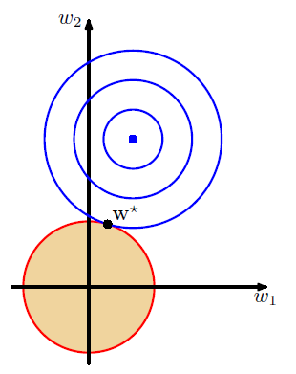
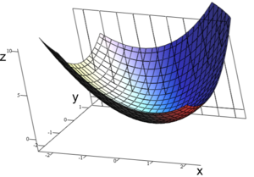
Geometrical Interpretation- Ridge Regression
s
w₀²+w₁² ≤ s
min {$\frac{1}{2}\sum_{n=1}^{N}{[\text{(}\text{w}\text{0}\text{+}\text{w}\text{1}\text{x}\text{n}\text{) −}\text{yn}\text{]}\text{2}}$ + λ {w₀²+w₁²}

Slide 24
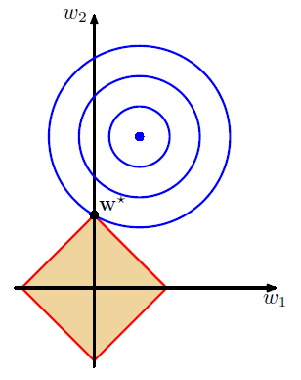
Geometrical Interpretation- Lasso Regression
s
s
|w₀|+ |w₁| ≤ s
min {$\frac{1}{2}\sum_{n=1}^{N}{[\text{(}\text{w}\text{0}\text{+}\text{w}\text{1}\text{x}\text{n}\text{)}\text{−}\text{yn}\text{]}\text{2}}$ + λ {|w₀|+ |w₁| }

Slide 25
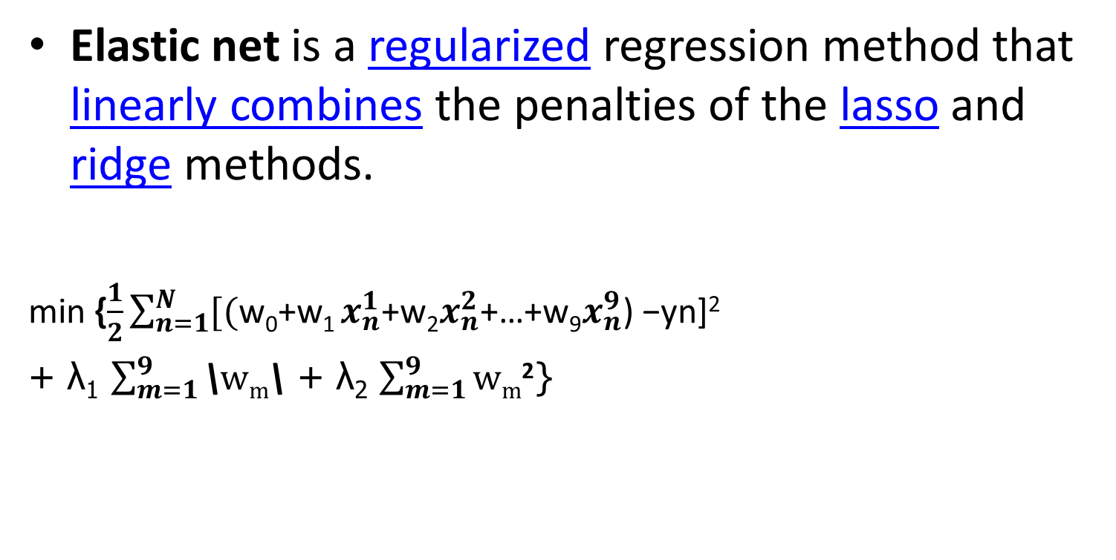
Elastic Net
Elastic net is a regularized regression method that linearly combines the penalties of the lasso and ridge methods.
min {$\frac{1}{2}\sum_{n=1}^{N}{[\text{(}\text{w}\text{0}\text{+}\text{w}\text{1 }x_{n}^{1}\text{+}\text{w}\text{2}x_{n}^{2}\text{+…+}\text{w}\text{9}x_{n}^{9}\text{) −}\text{yn}\text{]2}}$
+ λ₁ $\sum_{m=1}^{9}{\text{\backslash }\text{w}\text{m}\text{\backslash }}$ + λ₂ $\sum_{m=1}^{9}{\text{w}\text{m}\text{2}}$}

Slide 26
Bias-Variance Decomposition

Slide 27
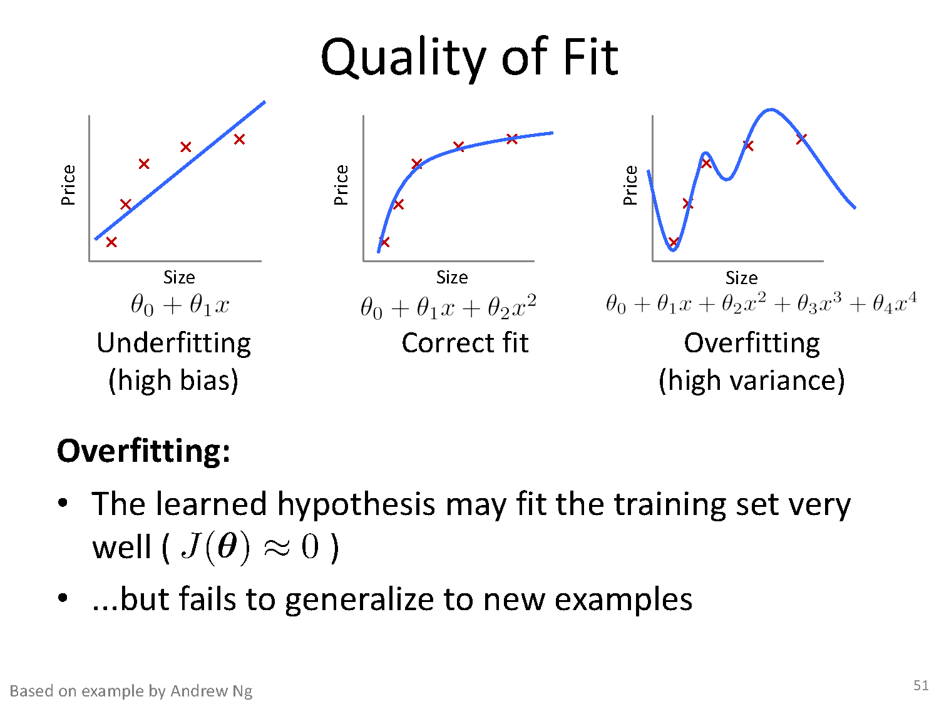

Slide 28
Bias-Variance Tradeoff
Bias: difference between what you expect to learn and truth
Measures how well you expect to represent true solution
Decreases with more complex model
Variance: difference between what you expect to learn and what you learn from a particular dataset (training data)
Measures how sensitive learner is to specific dataset
Increases with more complex model

Slide 29
Bias – Variance decomposition of error
E {( f (x) + ε − h (x)) }
2
D,ε
D
learned from data D
dataset and Irreducible error
true function
Irreducible error
Fix test case x, then do this experiment:
Draw size n sample D=(x₁,y₁),….(x_{n},y_{n})
Train linear regressor h_{D} using D
Draw one test example (x, f(x)+ε)
Measure squared error of h_{D} on that example x
What’s the expected error? The expected value is a weighted average of all possible values in a data set.

Slide 30
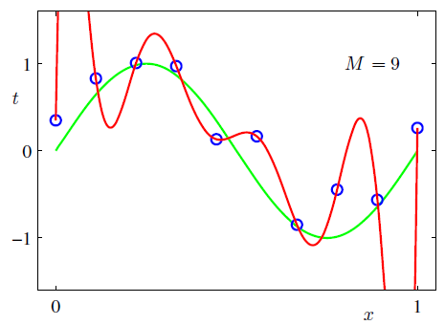
Bias-Variance

Slide 31



Bias – Variance decomposition of error
2
E_{D,ε} { ( f (x) + ε − h_{D} (x))
}
dataset and Irreducible error
true function
learned from D
Irreducible error
h(x) ≡ E_{D}{h_{D} (x)}
long-term expectation of learner’s prediction on this x averaged over many data sets D

Slide 32
Bias-Variance

Slide 33
Bias – Variance decomposition of error
2
E_{D,ε} { (f (x) − h_{D} (x))
}
h(x)=E {h (x)}
2
= E { ([ f (x) − h(x)] +[h(x) − h_{D} (x)]
}
D D
= E { [f (x) − h(x)]² +[h(x) − h_{D}(x)]² + 2[f (x) − h(x)][h(x) − h_{D} (x)]}
= E { [f (x) − h(x)]² +[h(x) − h_{D}(x)]²
+ 2[f (x) h(x) - f (x) h_{D}(x) − h(x) h(x) + h(x) h_{D}(x)] }
= E [f (x) − h(x)]² + E[(h(x) − h_{D}(x)])² ]
+ 2 (E[f (x) h(x) ] − E[f (x) h_{D}(x) ] − E[h(x) h(x) ] + E[h(x) h_{D}(x) )

Slide 34
Bias – Variance decomposition of error
2 (E[f (x) h(x) ] − E[f (x) h_{D}(x) ] − E[h(x) h(x) ] + E[h(x) h_{D}(x) )
2 (E[f (x)] h(x) −E[ f (x)]E[h_{D}(x)] − h(x) h(x) + h(x) E[h_{D}(x)])
f (x) h(x) - f (x) h(x) − h(x) h(x) + h(x) h(x)
=0

Slide 35
E_{D,ε} { ( f (x) + ε − h_{D} (x))²
Bias – Variance decomposition of error
}
= E [f (x) − h(x)]² + E[(h(x) − h_{D}(x)])² ] + σ ²
BIAS²
VARIANCE
Squared difference between actual f(x), and our “long-term” expectation for what the learner will do if we averaged over many
Squared difference between our long- term expectation for the learners performance, E_{D}[h_{D}(x)], and what we expect in a representative run on a dataset D
datasets D, E_{D}[h_{D}(x)]

Slide 36
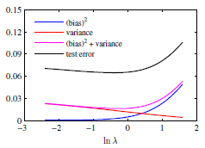
Relation between ln λ and variance, ln λ and bias
As λ increases variance comes down(red line)
As λ increases(w more constrained) bias also increases

Slide 37
Value of regularization parameter λ
If λ small, more flexible model, w can take larger values bias is low but variance is high
As λ increases, w more constrained. So bias also increases and variance is low
Right choice of λ is balance between bias and variance
0 < λ < 1
Pickup λ where the test error is minimum

Slide 38
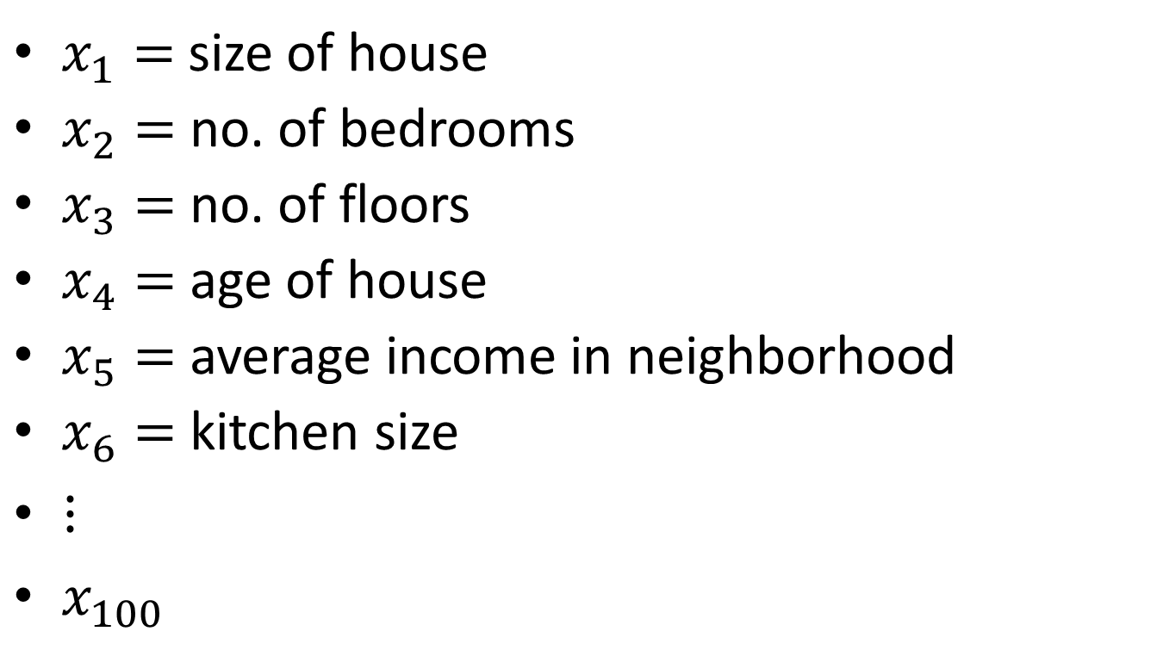
Addressing overfitting
$x_{1}=$ size of house
$x_{2}=$ no. of bedrooms
$x_{3}=$ no. of floors
$x_{4}=$age of house
$x_{5}=$average income in neighborhood
$x_{6}=$ kitchen size
$⋮$
$x_{100}$
Price ($) in 1000’s
Size in feet^2

Slide 39
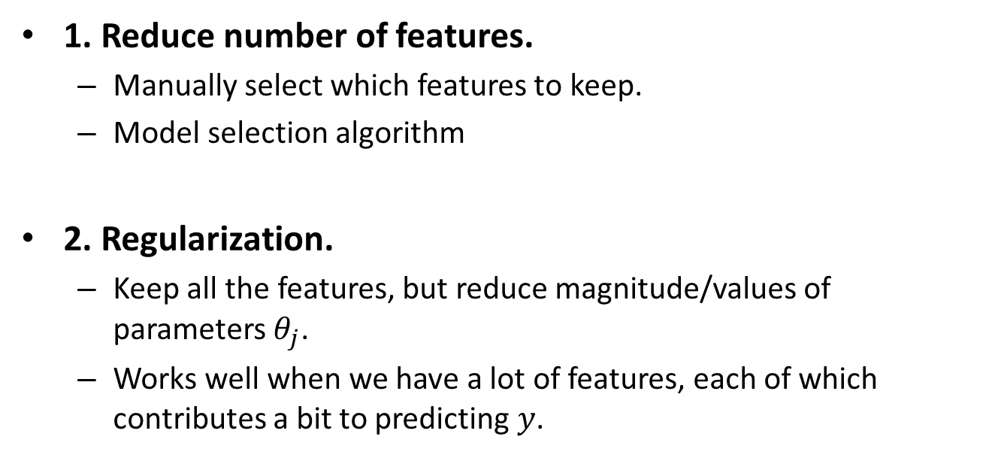
Addressing overfitting
1. Reduce number of features.
Manually select which features to keep.
Model selection algorithm
2. Regularization.
Keep all the features, but reduce magnitude/values of parameters $θ_{j}$.
Works well when we have a lot of features, each of which contributes a bit to predicting $y$.

Slide 40
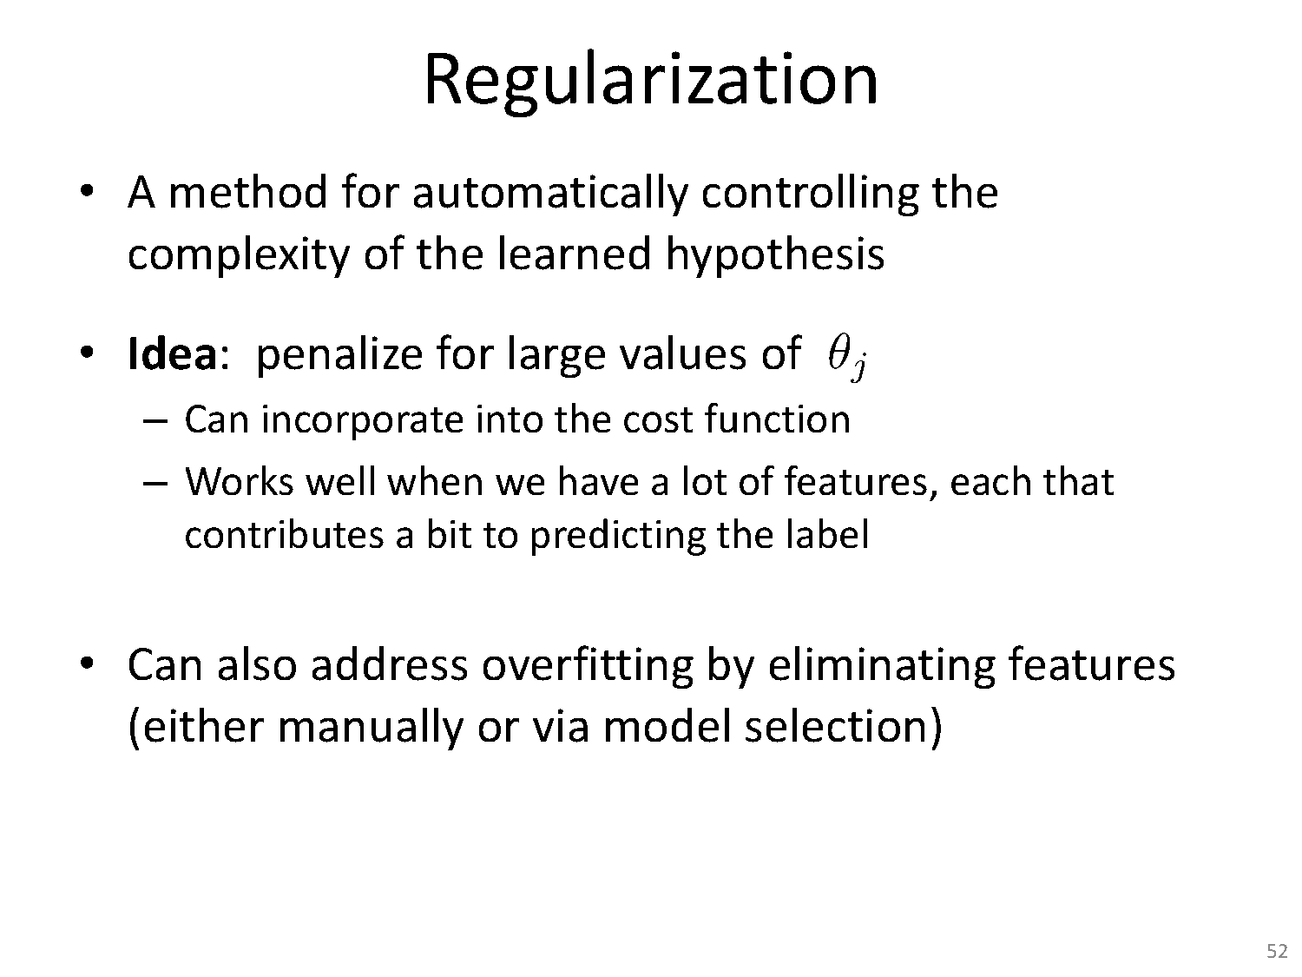

Slide 41
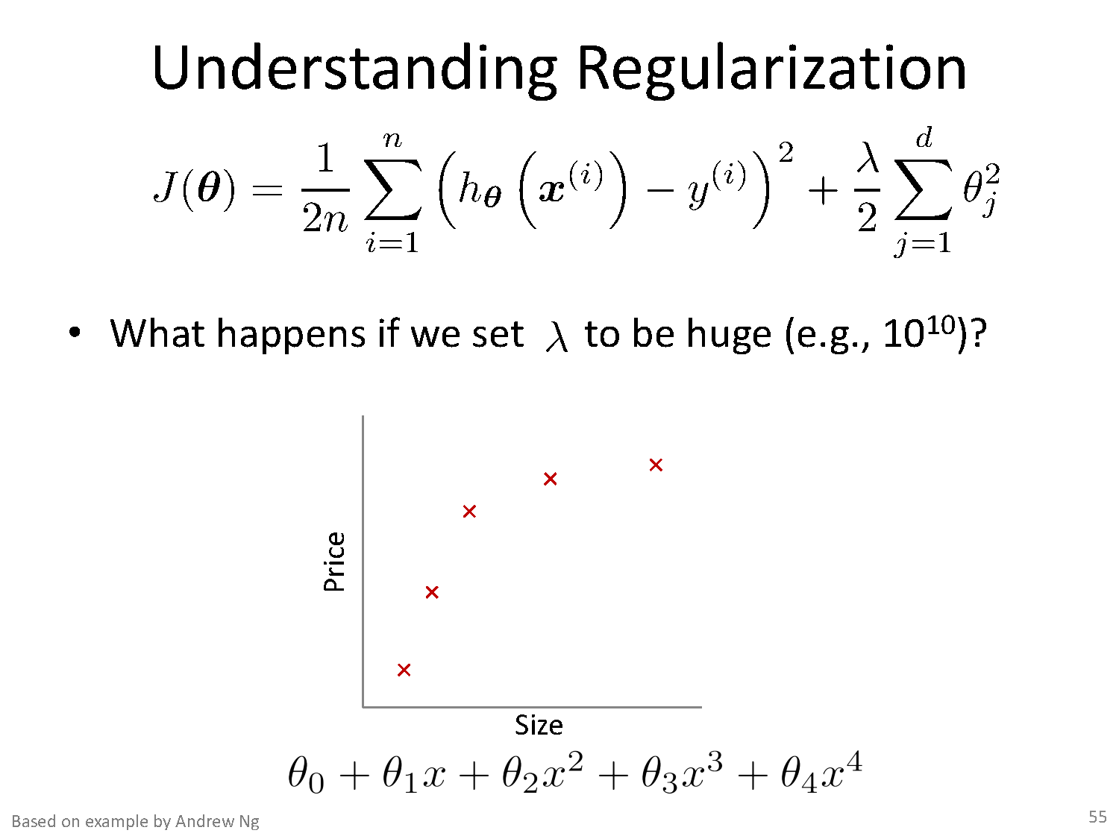

Slide 42
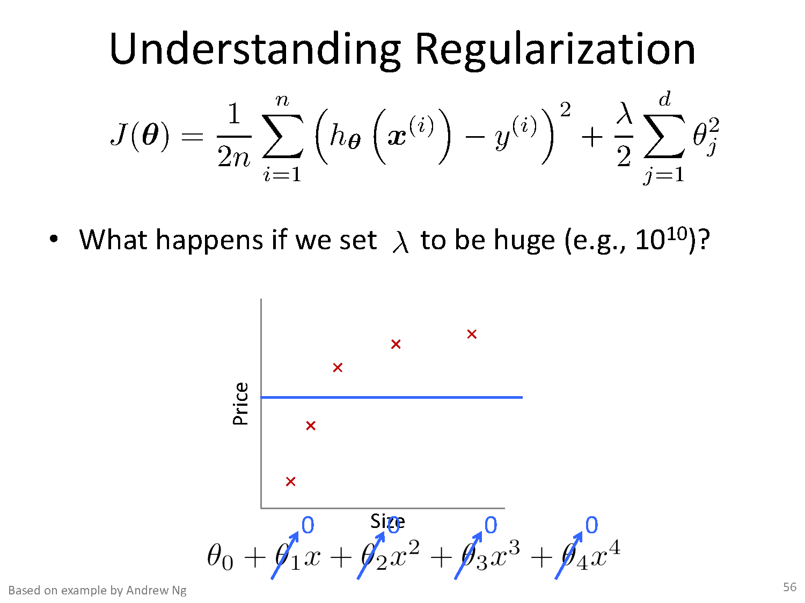

Slide 43
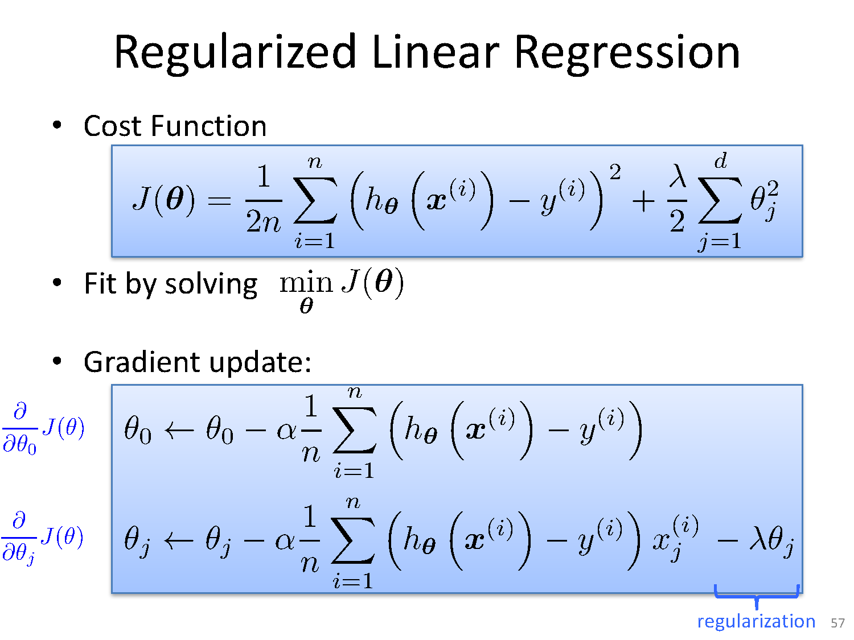

Slide 44
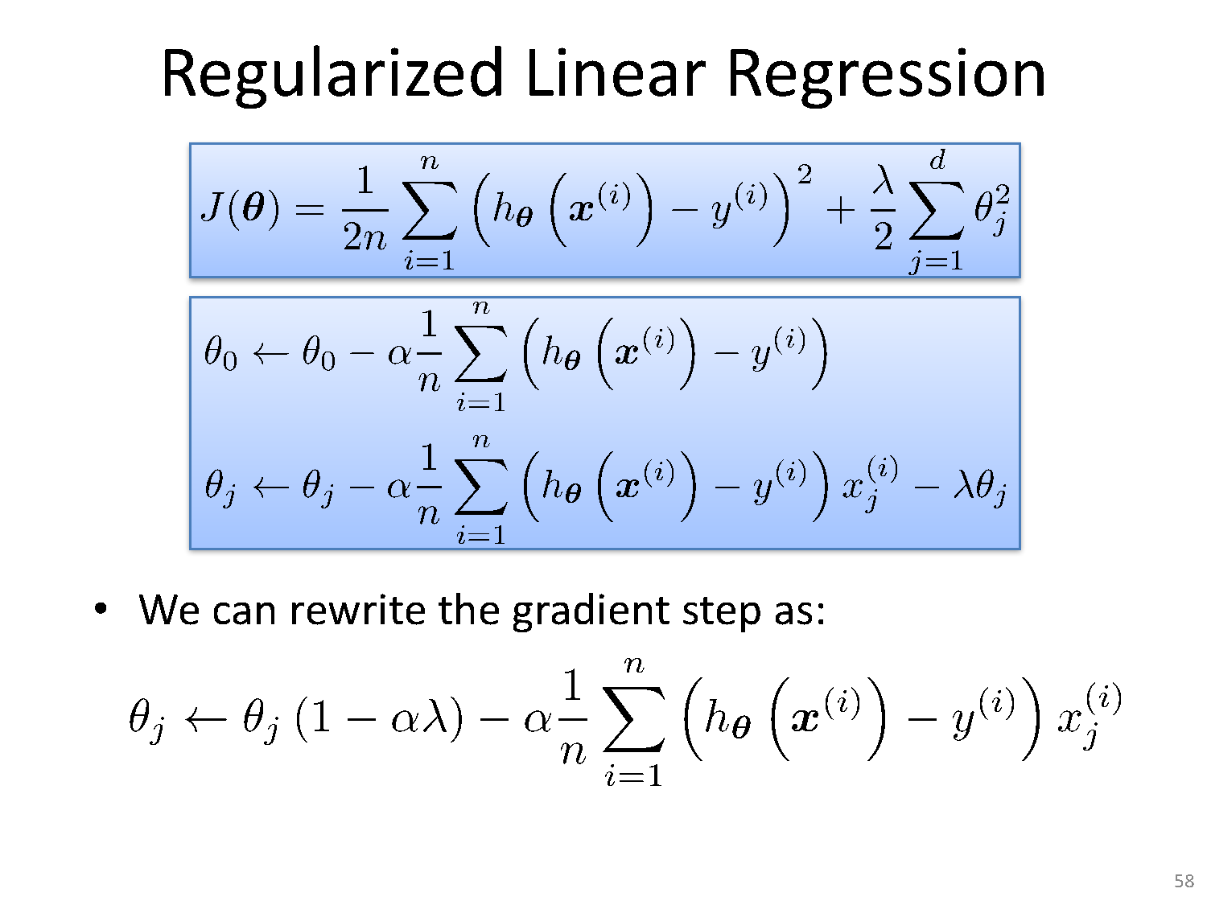

Slide 45
Good links
https://towardsdatascience.com/regularization-in-machine-learning-76441ddcf99a
https://www.youtube.com/watch?v=SjQyLhQIXSM
https://www.youtube.com/watch?v=2BH49JG_sTs&feature=emb_rel_pause
https://www.youtube.com/watch?v=EuBBz3bI-aA
Polynomial regression Python code
https://acadgild.com/blog/polynomial-regression-understand-power-of-polynomials
https://www.youtube.com/watch?v=NGf0voTMlcs

Slide 46
Mini project mark distribution
EDA and plots go hand in hand. Here is a distribution of those 8 marks ( EDA+ plots) 1) Outlier detection - (1 mark for finding outliers + 1 mark for plot) 2) Correlation - (1 mark for finding correlations+2 mark for the correlations plot) 3) Null Values- ( 1 mark for finding Null/Nans in data if they exist or not & 2 mark for plotting histograms of variables)

Slide 47
Mini project mark distribution
Rmse, R2, MSE metrics You do not need to compare the metrics across these models. You just have to calculate the above mentioned metrics for GD,SGD,MBGD

Slide 48
Mini project References
Detecting outliers
https://towardsdatascience.com/ways-to-detect-and-remove-the-outliers-404d16608dba
https://mc.ai/difference-between-batch-gradient-descent-bgd-minibatch-gradient-descentmgd-and-stochastic/
https://towardsdatascience.com/learning-parameters-part-3-ee8558f65dd7
https://www.geeksforgeeks.org/gradient-descent-algorithm-and-its-variants/?ref=rp

Slide 49
Thank You
27 April 2020

